Slide 1
Diagnostics of Pulsar
Magnetospheric Plasmas
Based on paper:
Pulsar electrodynamics inferred from frequency-dependent
circular polarization diversity (2026, A&A, 710, A282)
Shunshun Cao, Yanjun Guo, Jinchen Jiang,
Kejia Lee, Weiyang Wang, Renxin Xu
Shunshun Cao
Peking University
School of Physics
Department of Astronomy

Slide 2
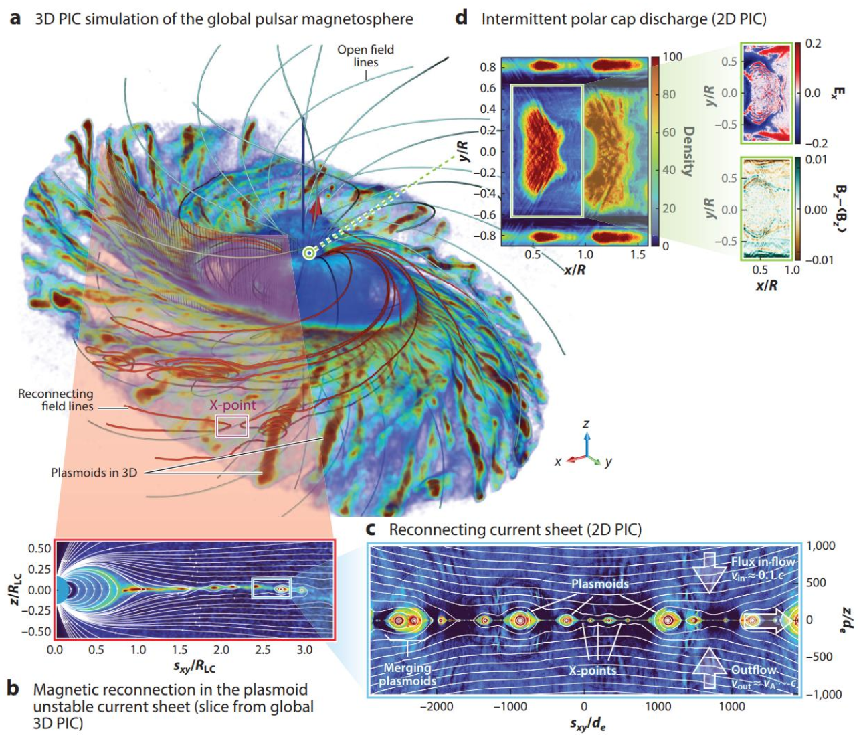
1. Background
Pulsar magnetosphere: natural strong-field plasma laboratory.
To make better use of this lab,
we’d better know more of its
parameters.
e.g., plasma number density,
Lorentz factors,
……
Particle acceleration,
Coherent emission,
High-energy emission,
Propagation effects,
……
Philippov & Kramer 2022 ARA&A

Slide 3

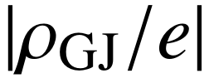
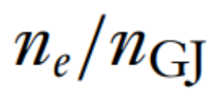
Magnetospheric plasma number density:
Important reference——Goldreich & Julian (GJ) charge density (Goldreich & Julian 1969 ApJ)
Charge density of corotating magnetosphere → what about number density?
Number density reference——GJ number density =
But real number density could be higher
[e.g., 1e/cc = (21e⁺ & 20e⁻)/cc = (2e⁺ & e⁻)/cc]
Introduce plasma multiplicity κ:

Slide 4
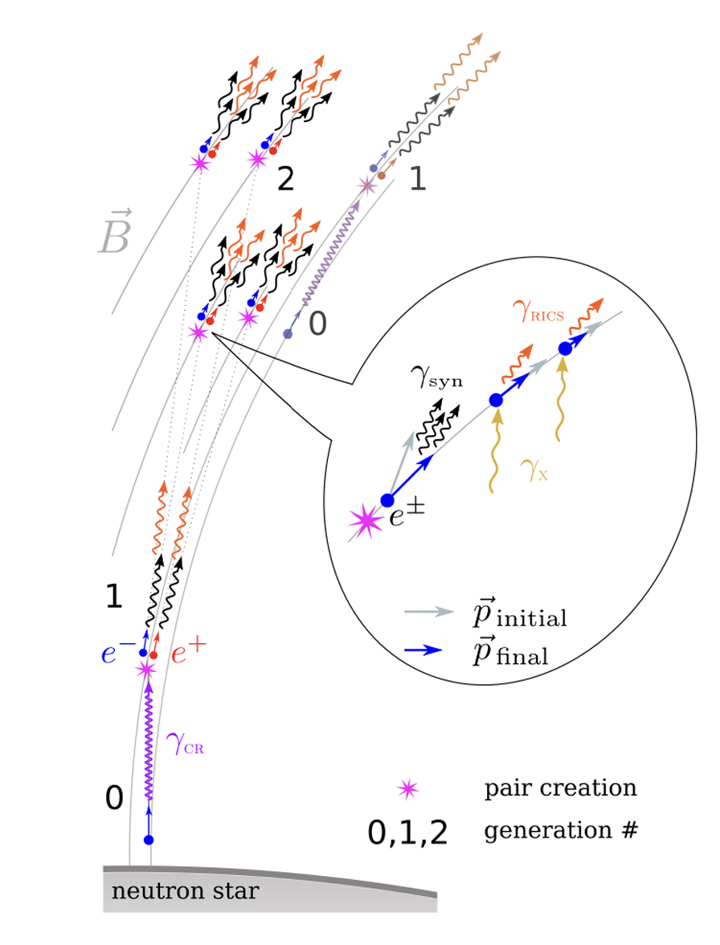

Lorentz factor and pair production (cascade):
Both multiplicity κ and Lorentz factor γ are
determined by pair cascade.
Pair cascade modeling constrains κ and γ to be:
$κ<\sim {10}^{3}−{10}^{5}$
$γ\sim {10}^{1}−{10}^{3}$
(Philippov & Kramer 2022 ARA&A,
Timokhin & Harding 2015 ApJ,
Gurevich & Istomin 1985 ZETF,
……)
But how to obtain κ and γ from data?
Amato 2024 arxiv

Slide 5


Plasma diagnostics for pulsar magnetosphere or pulsar winds
—— two ways
Modeling the Very-High-Energy (VHE) spectra of pulsar wind nebulae (PWNe)
c ⬅➔ magnetospheric current ⬅➔ of pulsars
⬅➔ pulsar wind electron radiation energy ⬅➔ spectra of PWNe
(de Jager 2007 ApJ, Spencer & Mitchell 2025 A&A, ……)
(2) Modeling pulsar radio signal
· Modeling eclipse of binary pulsars (e.g. Lyutikov & Thompson 2005 ApJ)
· Modeling propagation effects in solitary pulsar magnetosphere
(e.g. Petrova 2003 A&A)

Slide 6
Questions in former pulsar plasma diagnostics:
Very few pulsars (~10) have been diagnosed.
For radio approach, modeling is made on integrated profiles.
Mutual cancellation of circular polarization may affect the diagnostics.
Our work:
Extend the radio approach to single pulses, with Bayesian analysis.
Using normal pulsars in FAST released data.

Slide 7
2. Model & Method
Circular polarization arises from wave mode coupling (Lyubarskii & Petrova 1999 ApSS)
[Limiting polarization effect]
Basic physical picture: magnetic field plasma particles waves (initially linearly pol.)
Multiplicity and
Lorentz factor
affects the reponse
of plasma particles
should be
reflected in circular polarization.
Quasi-homogeneous plasma:
When B-field along ray trajectory changes,
wave polarization follows B-field.
Strongly inhomogeneous plasma:
Wave polarization fails to follow B-field
➔ Another mode emerges ➔ add to form circular pol.

Slide 8

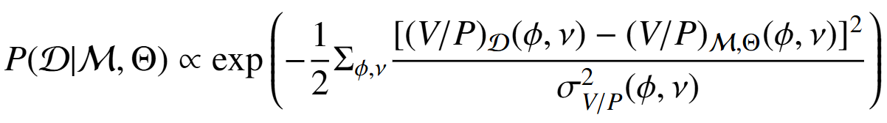
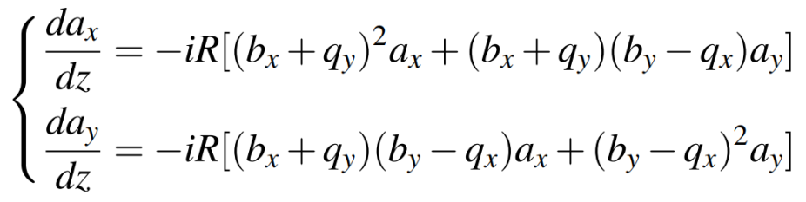
Bayesian analysis:
Parameters:
κ, γ, z₀
3 pulsars from FAST released data:
V/P v.s. frequency on single pulse
phase bins.
Solving mode coupling equation
(Lyubarskii & Petrova 1999 ApSS)
V/P: circular polarization fraction
P = sqrt(L²+V²)
L: linear polarization intensity
V: circular polarization intensity
Cao et al. 2026 A&A

Slide 9
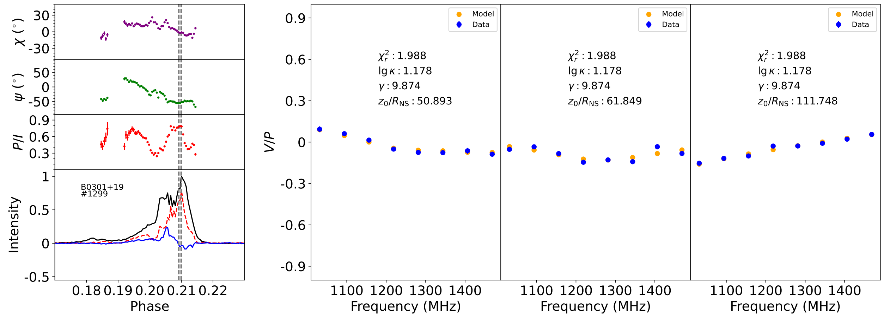
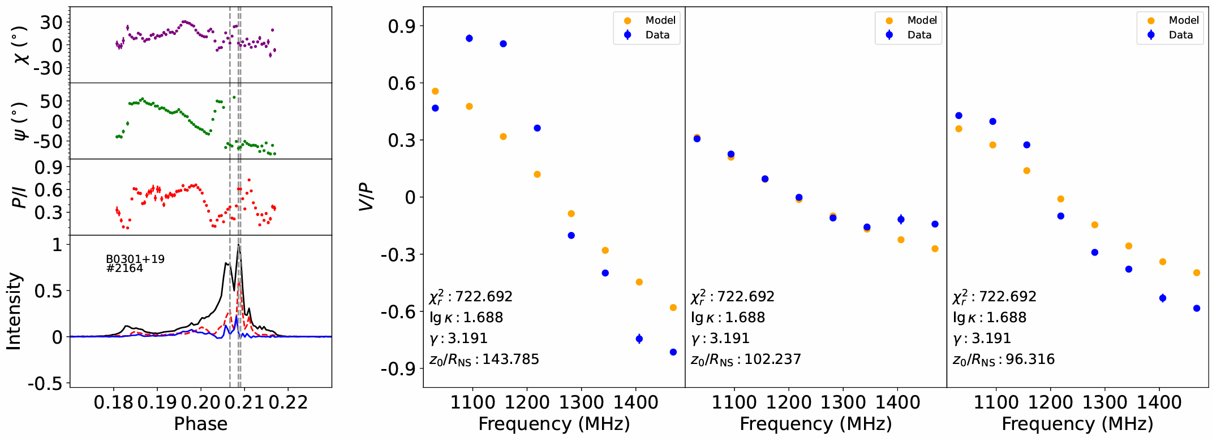
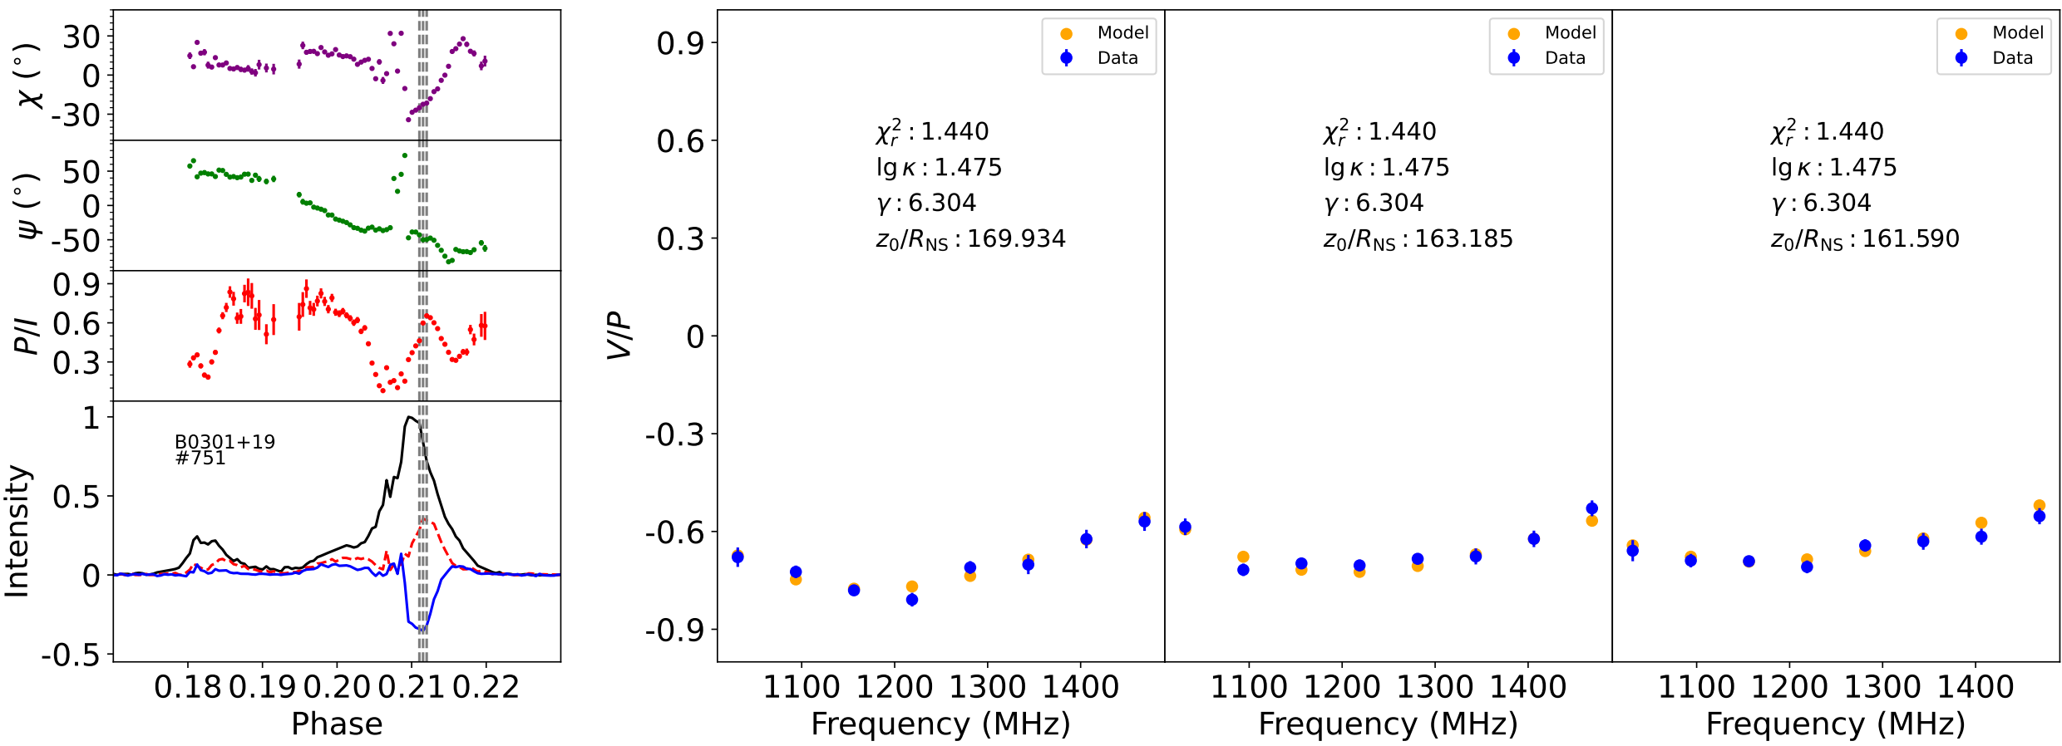
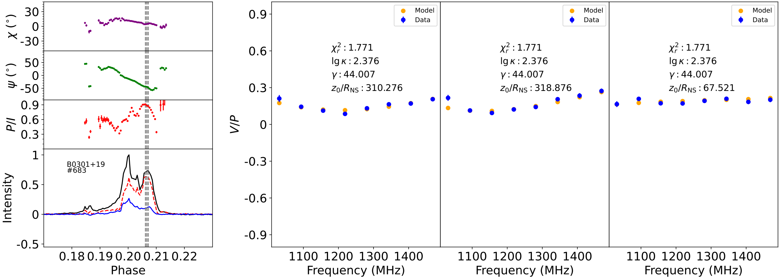
3. Results & Discussion
Example 4: bad fitting
Example 2: Large right-handed circular pol.
Example 1: Small left-handed circular pol.
Example 3: handedness changing with frequency.
The limiting polarization effect could result in the diversity
of circular polarization spectra, though not quantitative enough.
Cao et al. 2026 A&A

Slide 10
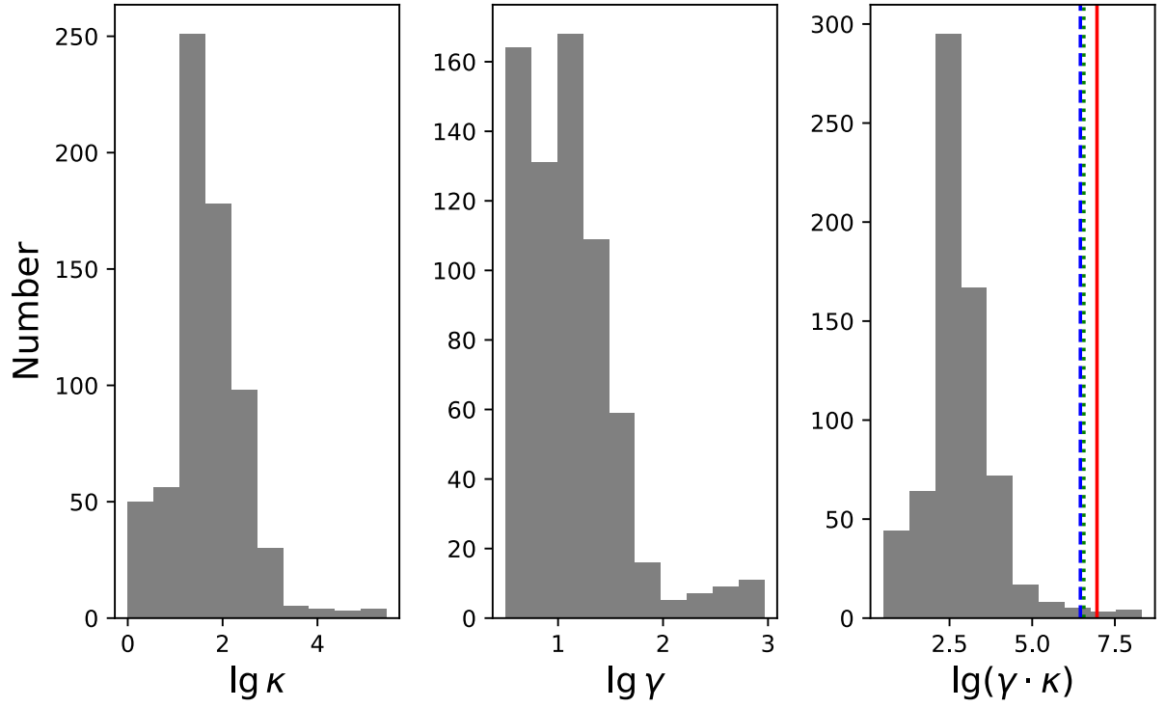
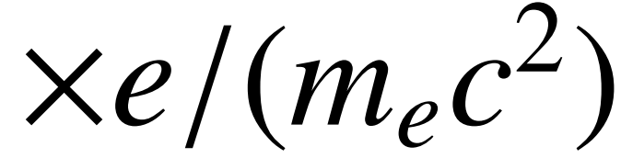

κ and γ inferred from fitting 679 pulses of B0301+19: $κ\sim {10}^{2}$, $γ\sim {10}^{1}$.
κ·γ is the normalized particle energy density ($κn_{GJ}∙{γm}_{e}c^{2}$)
should be constrained by polar cap acceleration electric potential.
Colored vertical lines: modeled acceleration potential
(Ruderman & Sutherland 1975, Arons & Scharlemann 1979, …)
Particle energy
involved in radio
emission processes
Polar cap electric
potential energy
<<
Cao et al. 2026 A&A

Slide 11
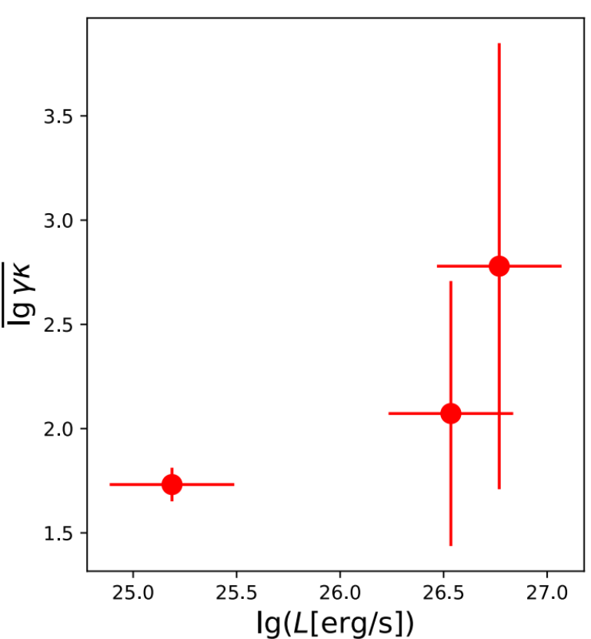
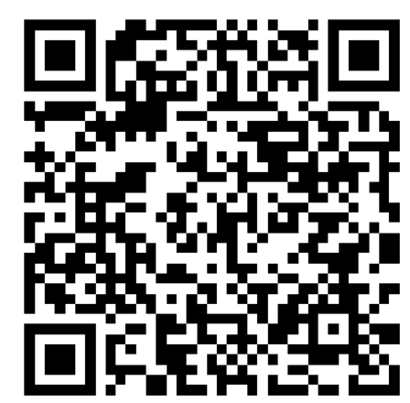
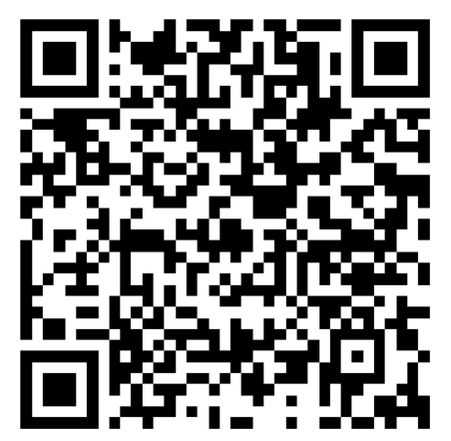
The κ·γ should also be related to radio luminosity…
But there are too few points to state that.
Our method could be applied on more pulsars!
Conclusion：
· Pulsar plasma diagnostics: VHE or radio
· Radio approach: modeling propagation effects
· Application on single pulses: Infer κ & γ
from circular polarization spectra
Thank you.
Visit my homepage to view two slides
introducing limiting polarization theory
and VHE pulsar plasma diagnostics

Slide 12
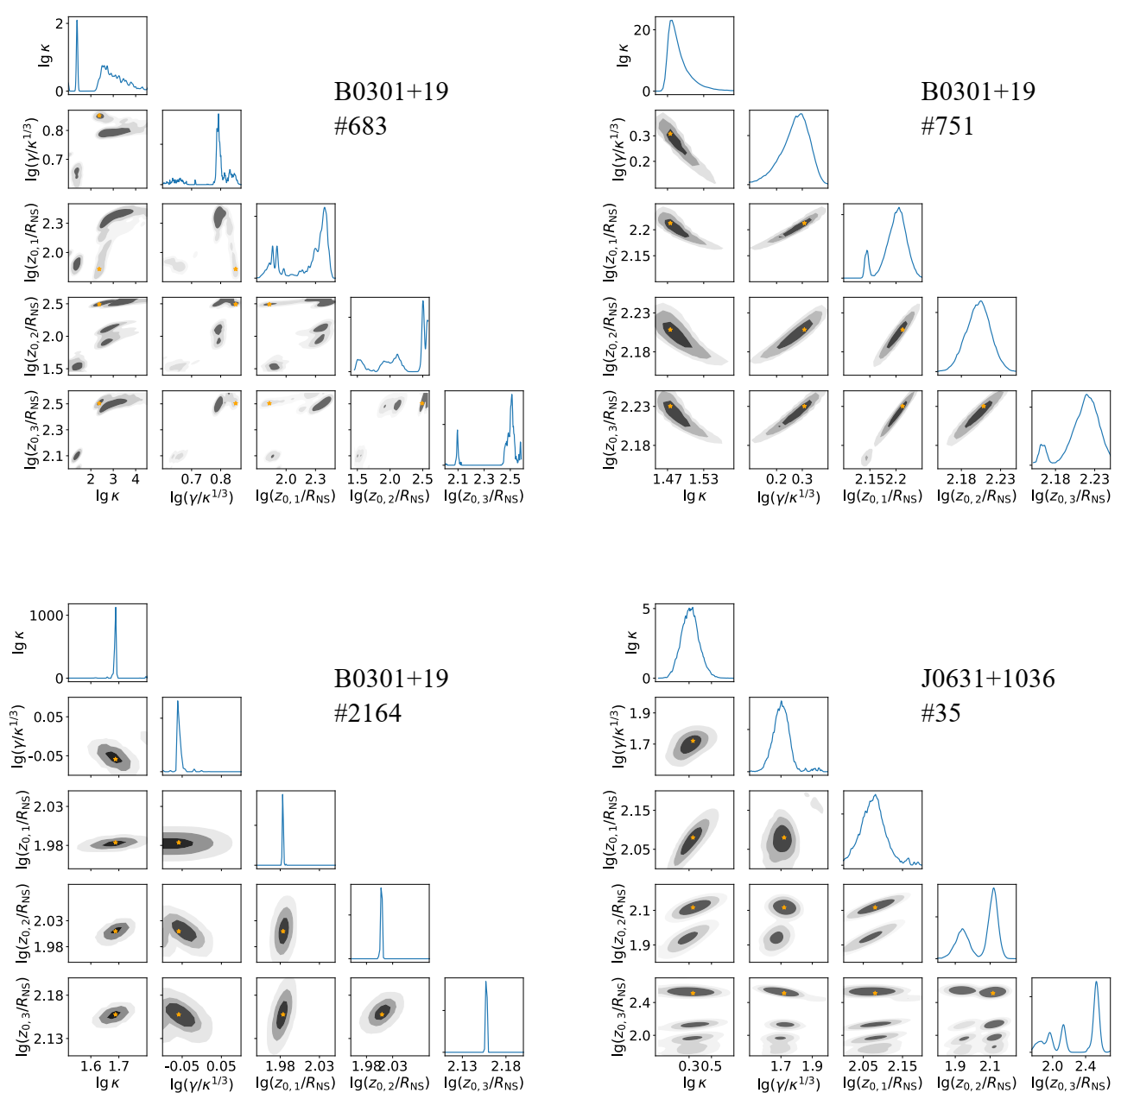
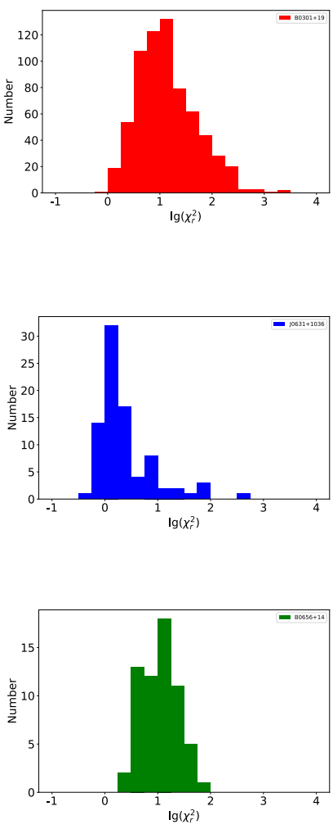
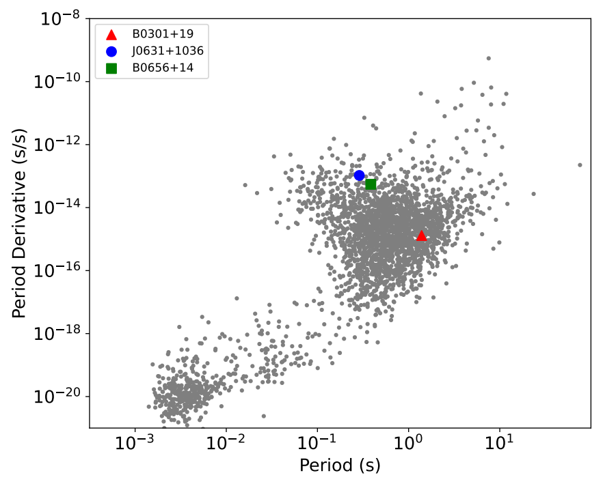

Backup

